Slide 1

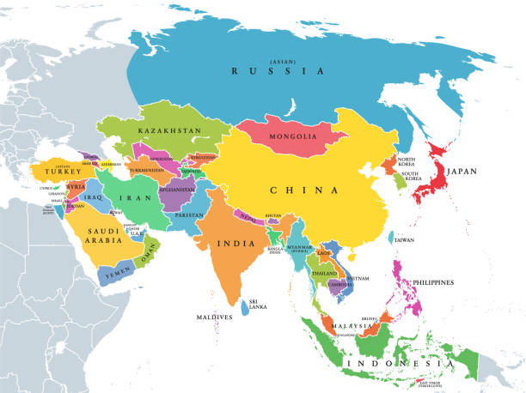

Slide 2




TABLE OF CONTENTS
Why Study Asia?
Popular destinations for study abroad in Asia
Factors to consider when choosing Asia
Common Application Requirement
Overview and Process (Stages) of Application
Common scholarship in Japan, China & Thailand
Common scholarship in other Asian countries
QUESTIONS AND ANSWERS/ DISCUSSIONS/ COMMENTS

Slide 3
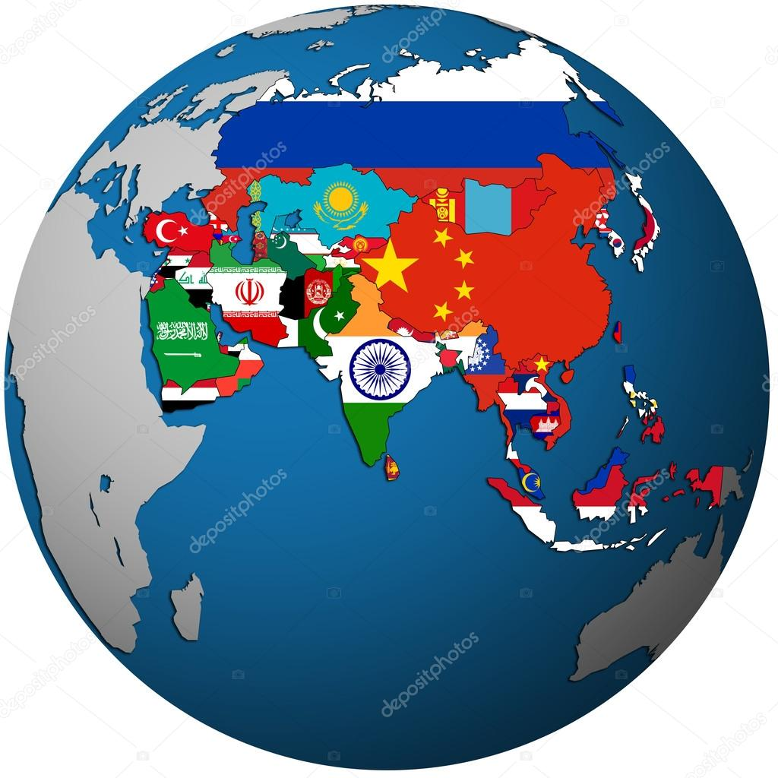

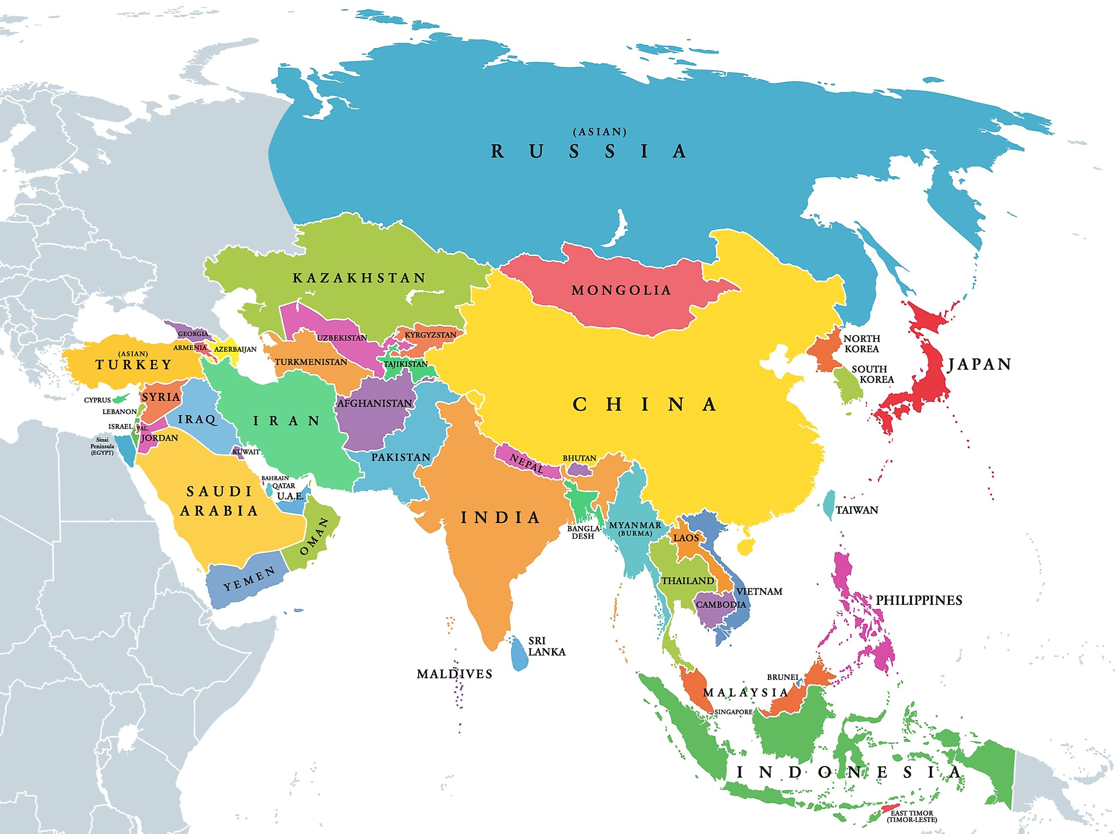
WHY ASIA?
Diverse Cultures
Affordability
Educational Opportunities
Language Acquisition
Networking and Career Opportunities
Global Perspective
Personal Growth

Slide 4

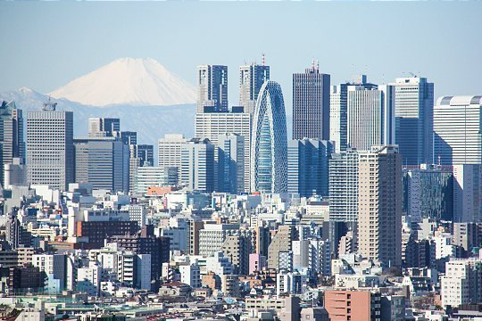
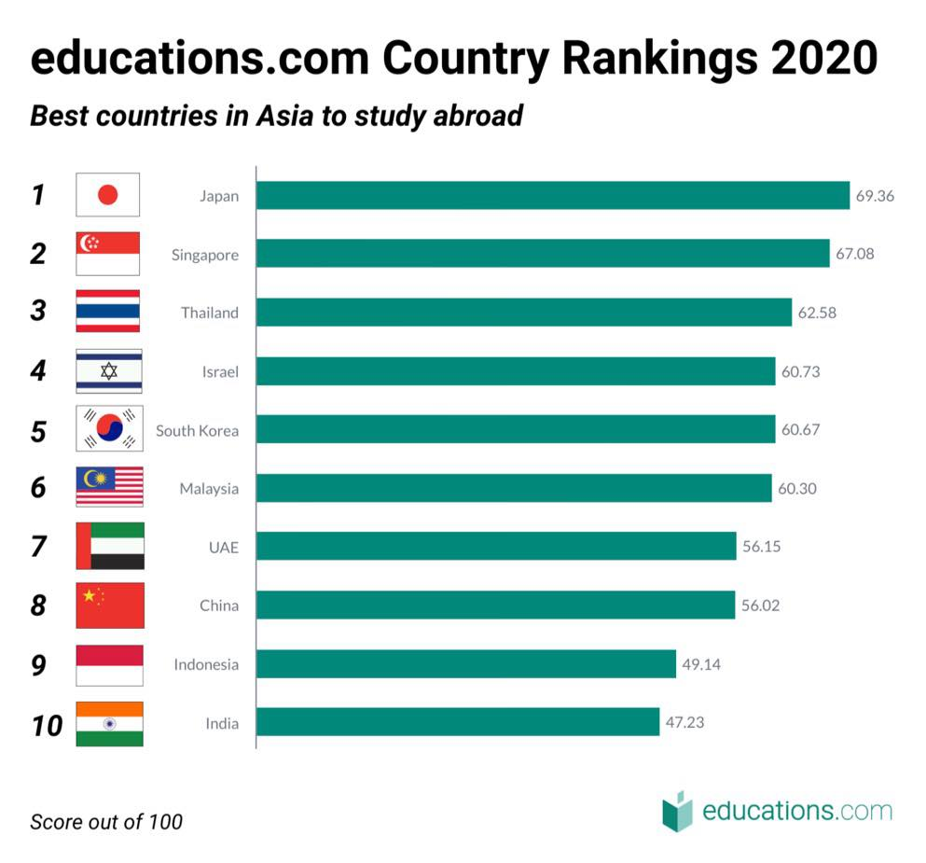



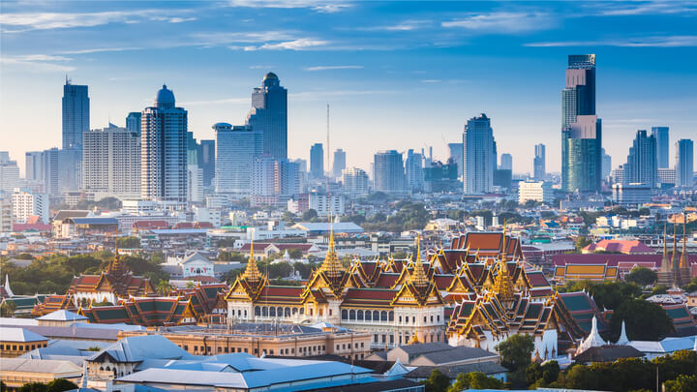



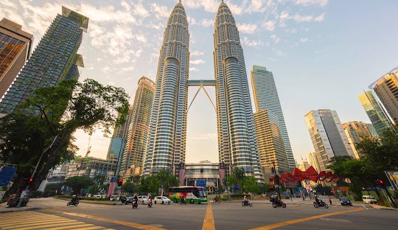


POPULAR DESTINATION FOR STUDY ABROAD IN ASIA

Slide 5

FACTORS TO CONSIDER WHEN CHOOSING ASIA
Factor | China | Japan | Thailand | Singapore | South Korea | Taiwan | Qatar | Saudi Arabia | Malaysia | Turkey | UAE
Visa | *** | **** | *** | ***** | **** | **** | ** | *** | **** | **** | *****
Affordability/Cost of Living | **** | *** | *** | ** | *** | *** | ** | *** | **** | **** | ****
Scholarships | *** | ** | ** | **** | *** | ** | * | ** | *** | **** | ****
Language (Ease of communication in English) | ** | *** | ** | **** | *** | *** | * | * | **** | ** | *****

Slide 6





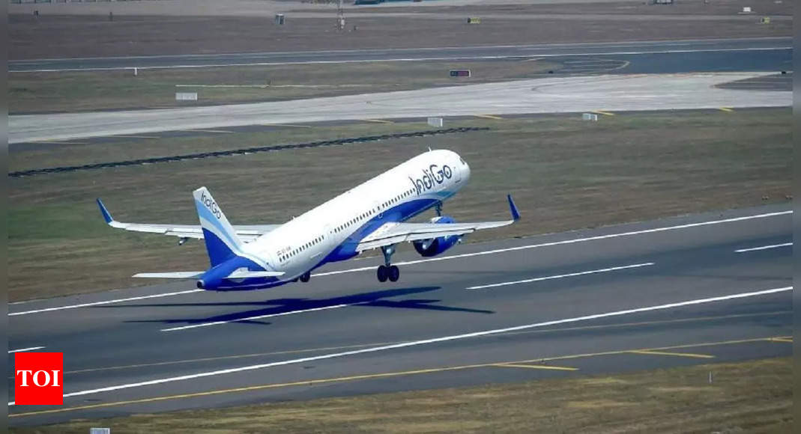
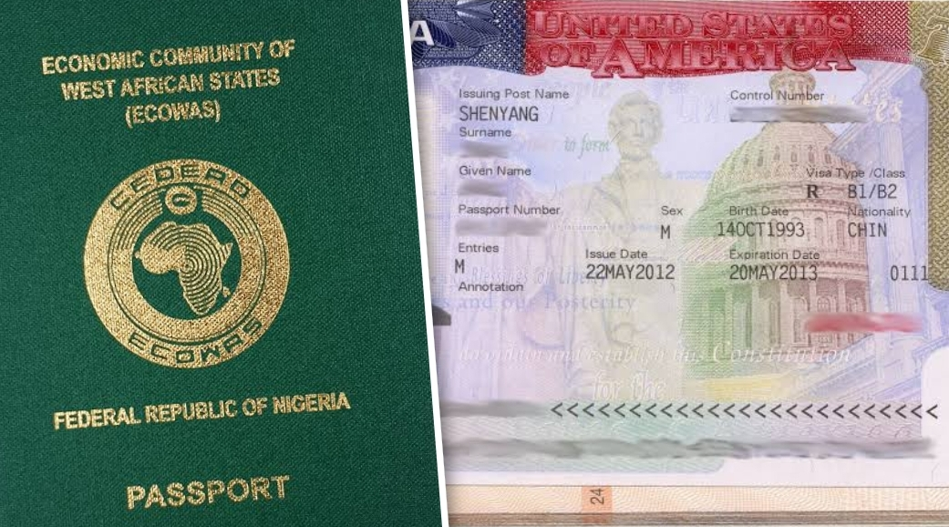

OVERVIEW and PROCESS (STAGES) OF APPLICATION
DOCUMENTATION
Transcript
Language Proficiency
Passport
APPLICATION PROCESS
Essays. Cold email, LOR, account creation
SUBMIT AND MONITOR
Regular email check
RESEARCH
Universities
Funding options
Countries
REJECTION
ACCEPTANCE
REJECT
ACCEPT
TAKE OFF
VISA APP
FLIGHT BOOK

Slide 7
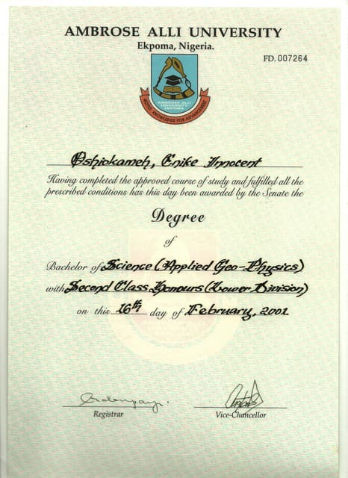
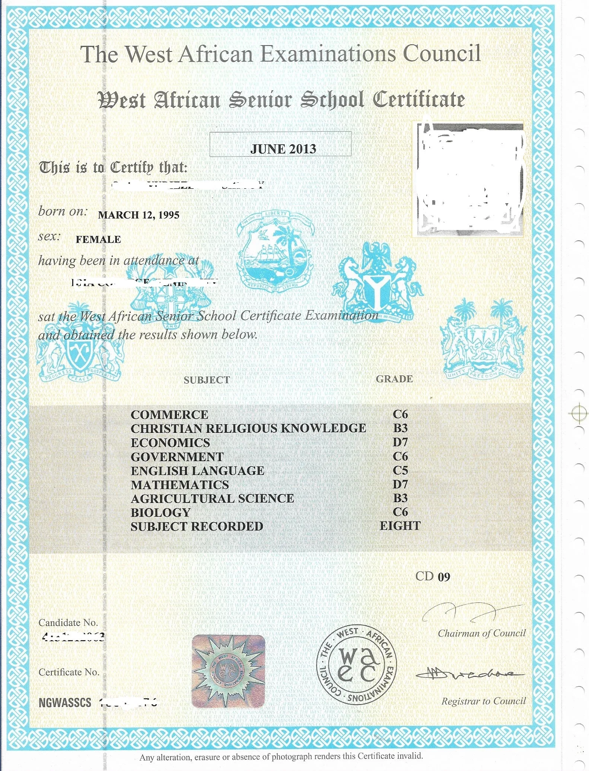
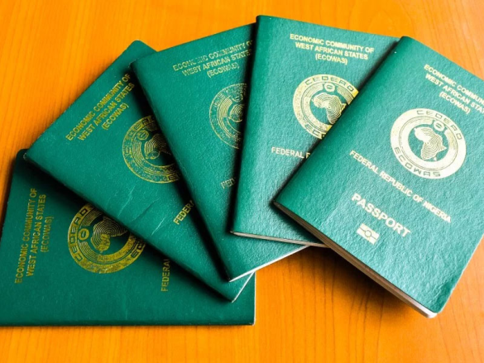


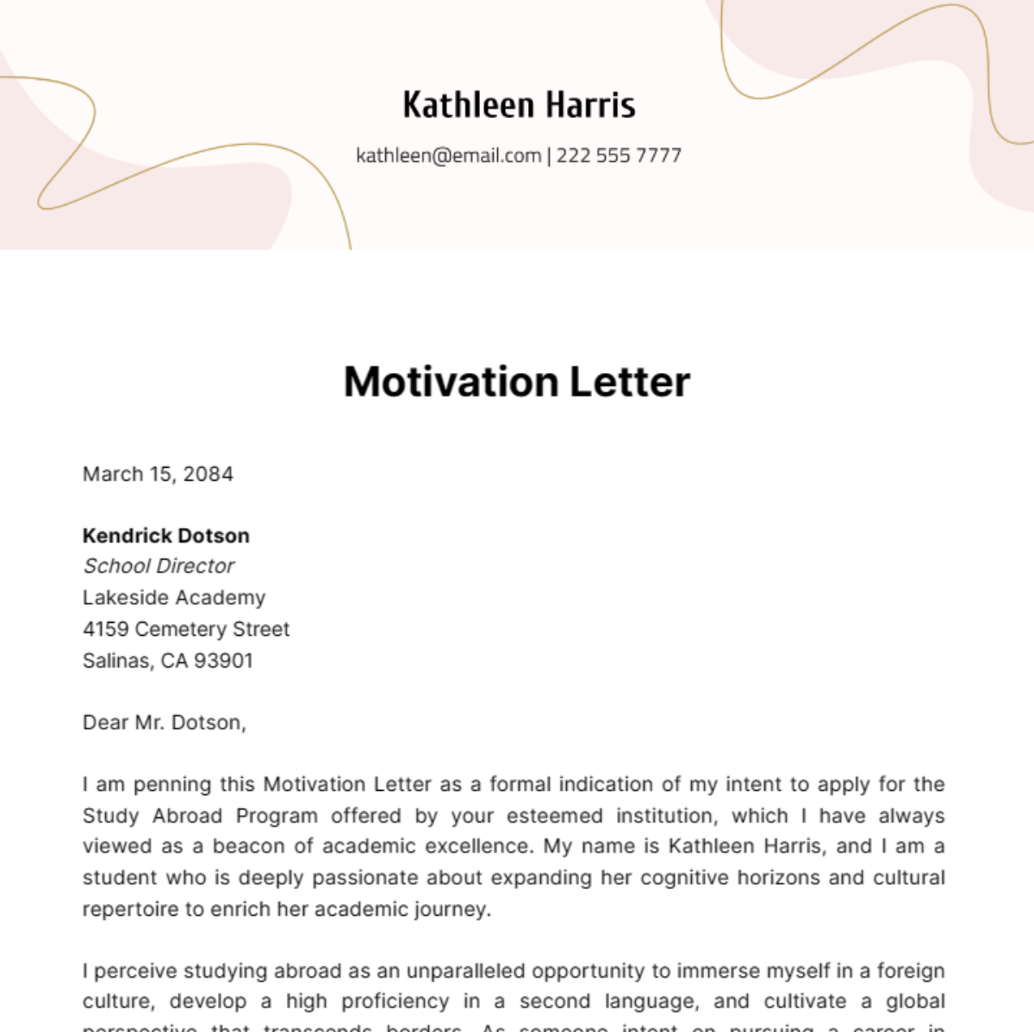
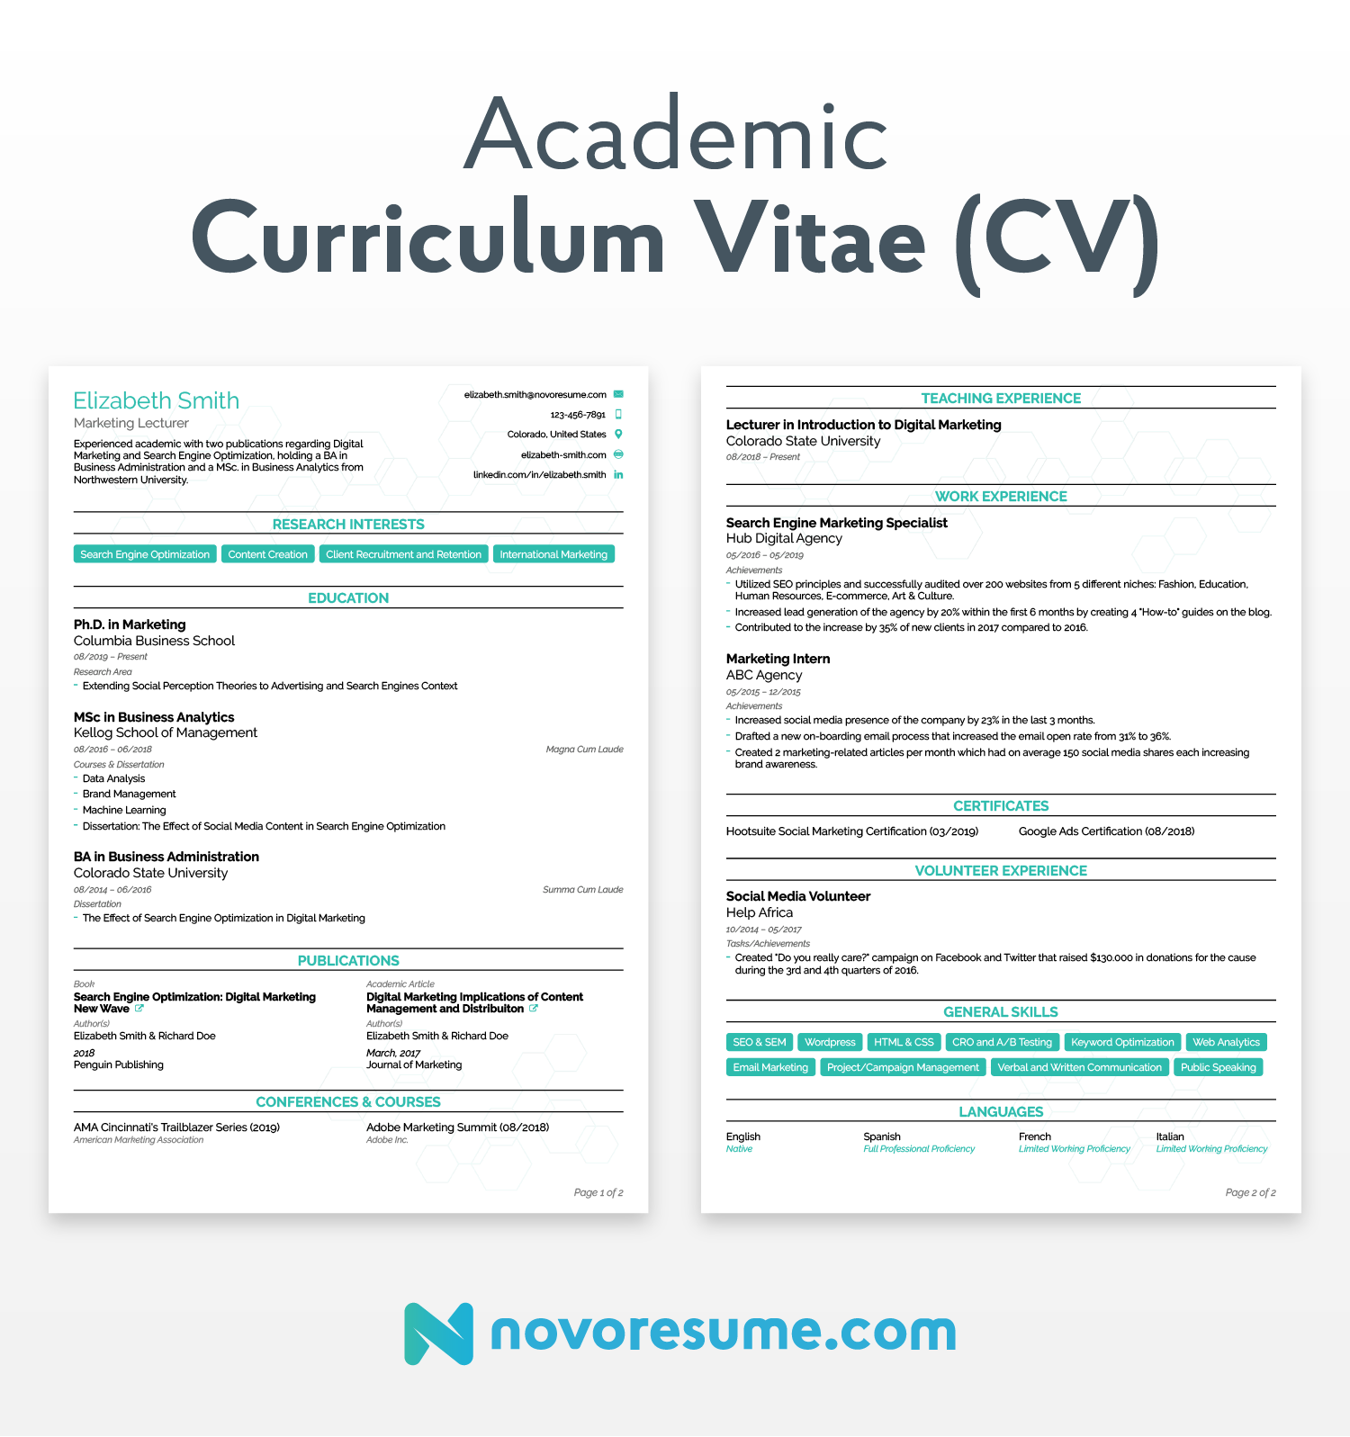
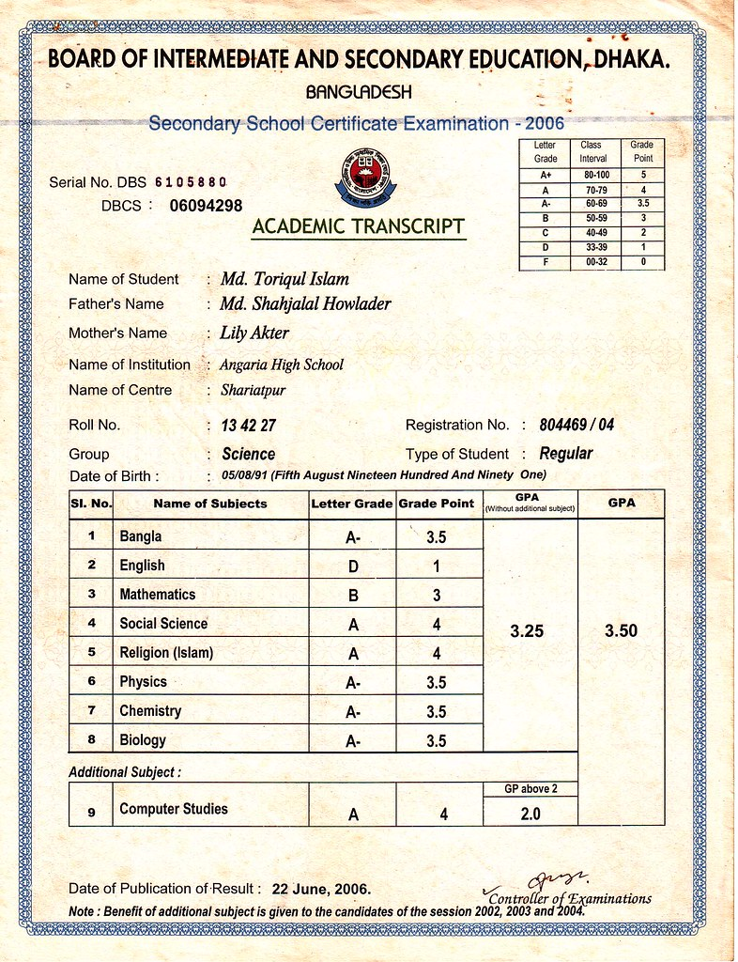


COMMON APPLICATION REQUIREMENT
BEFORE APPLICATION
DURING APPLICATION
International Passport
Academic Certificate
English Language Proficiency
Academic Transcripts

Slide 8
COMMON SCHOLARSHIP IN JAPAN, CHINA & THAILAND
JAPAN
Scholarship type | Programs/Field | Level
MEXT scholarship | Any | All
Honjo International Scholarship Foundation | Any | MSc & PhD
Joint Japan World Bank Graduate Scholarship Program | key areas of development | MSc
THAI
CHINA
Scholarship type | Programs/Field | Level
Chulabhorn Graduate Institute Scholarship. | Chemistry, Environment, Biology, medicine | MSc
Graduate Scholarship Program for ASEAN and NON-ASEAN Countries Chulalongkorn | Chula Graduate programs | MSc & PhD
JGSEE Scholarship | Energy and Environment | MSc &PhD
Sirindhorn International Institute of Technology (SIIT) Scholarships | Engineering | MSc &PhD
Scholarship type | Programs/Field | Level
China Scholarship Council | Any | All
Jiangsu Government Scholarship | Any | All
MOFCOM Scholarship | Any | MSc & PhD
Schwarzman Scholars | Any | MSc
Zhengzhou University President Scholarship |  | PhD

Slide 9
COMMON SCHOLARSHIP IN OTHER ASIAN COUNTRIES
Country | Scholarship type | Programs/Field | Level
TURKEY | Türkiye Scholarships | Any | All
MALAYSIA | Malaysian Technical Cooperation Program (MTCP) | Specific programs | MSc
TAIWAN | Taiwan Scholarship Program | Any | All
SOUTH KOREA | Global Korea Scholarship, NIIED | Any | All
QATAR | Doha Institute Scholarships Hamad bin Khalifa University Scholarship | Social Science/ art/Humanities Any | MSc All
SAUDI ARABIA | King Fahd University Scholarships King Abdulaziz Scholarship | Any Any | MSc, PhD, MBA All
UAE | Abu Dhabi University Scholarship | Any | BSc & MSc
SINGAPORE | Singapore International Graduate Award (SINGA) | Biomedicine, Engineering, Computing and Information science, Physical science | MSc, PhD,

Slide 10


https://www.kmutt.ac.th/sfa/list-scholarships/
QUESTIONS AND ANSWERS/ DISCUSSIONS/ COMMENTS

